Slide 1
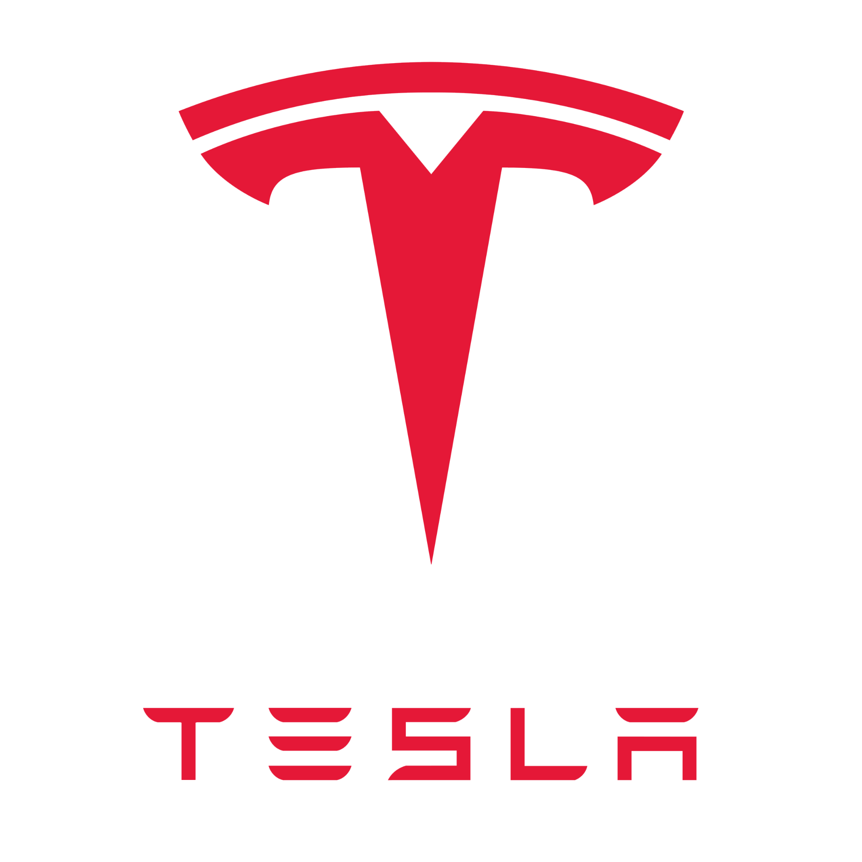
Team 7: Naz, Kayley, Mike, & Valeria
Notes:
valeria

Slide 2
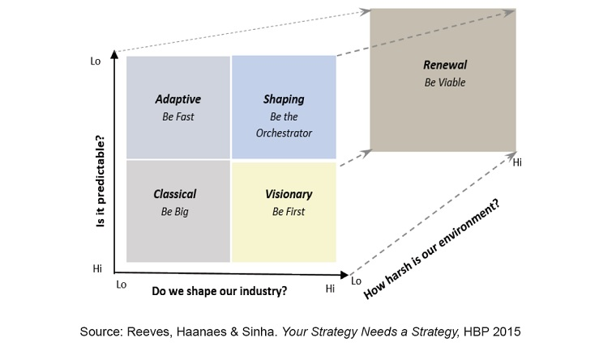
The Visionary Approach
Visionary firms can reliably create or re-create an environment largely by themselves. Visionary firms win by being the first to introduce a revolutionary new product or business model. Though the environment may look uncertain to others, visionary leaders see a clear opportunity for the creation of a new market segment or the disruption of an existing one, and they act to realize this possibility.
Notes:
Valeria
Visionary firms can reliably create or re-create an environment largely by themselves. Visionary firms win by being the first to introduce a revolutionary new product or business model. Though the environment may look uncertain to others, visionary leaders see a clear opportunity for the creation of a new market segment or the disruption of an existing one, and they act to realize this possibility.

Slide 3
Characteristics of Visionary Companies
A firm can be the first to apply a new technology or to identify and address a major source of customer dissatisfaction or a latent need.
The firm can innovate to address an old industry business model or can recognize a megatrend before others see and act on it.
Firms deploying a visionary approach also follow a distinct thought flow
Notes:
Valeria
A firm can be the first to apply a new technology or to identify and address a major source of customer dissatisfaction or a latent need.
They can innovate to address an old industry business model or can recognize a megatrend before others see and act on it.
Firms deploying a visionary approach also follow a distinct thought flow which I will show on the next slide

Slide 4
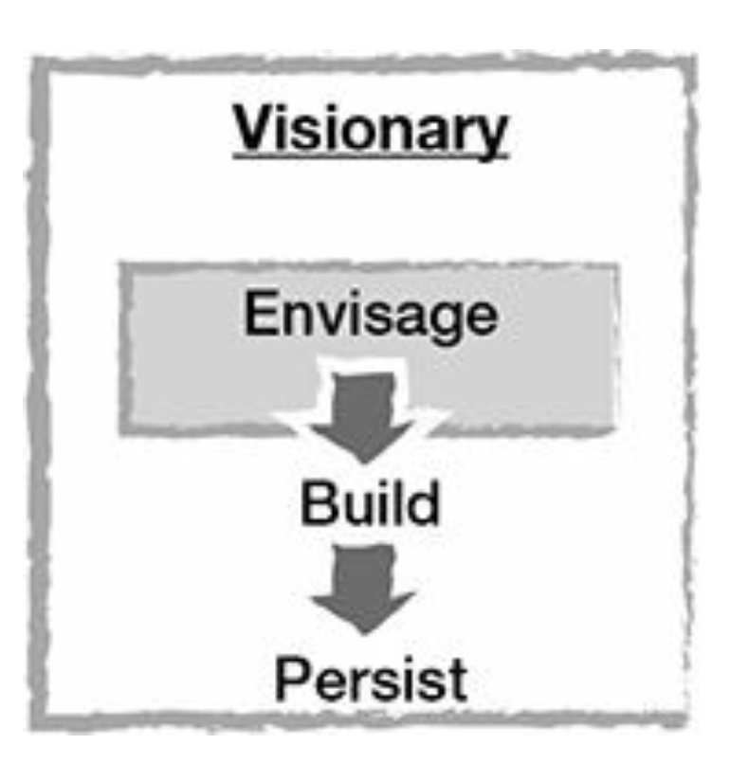
Visionary Thought Flow
Envision
Deploy
Persist
Notes:
valeria
First, visionary leaders envisage a valuable possibility that can be realized. Then they work single-mindedly to be the first to build it. Finally, they persist in executing and scaling the vision until its full potential has been realized
I will now hand it over to kayley who will present Tesla and their visionary approach

Slide 5
Tesla - An Industry Disruptor
An innovative automotive company specializing in EVs and energy solutions. Known for its cutting-edge tech and visionary approach.
Reshaped the automotive industry by pioneering the adoption of EVs.
Examples: autonomous driving, battery tech, direct-to-consumer sales, EVs
Notes:
kayley

Slide 6
Visionary Environment Checklist
Automotive Industry
Your industry provides a white-space opportunity or is ripe for disruption.
Your industry can be (re)shaped by an individual firm.
Your industry is marked by sleepy incumbents.
Your industry is suffering from unsatisfied consumers and unmet needs.
Your industry displays high growth potential.
Innovation in your industry is subject to few regulatory barriers.
Notes:
kayley
Particularly when it comes to EVs, self-driving vehicles, and sustainable approaches to manufacturing there is plenty of room for disruption and shaping.
Yes, a firm can shape the way manufacturing and distribution is approached, along with product offerings. Tesla reshaped the industry with its approach and processes associated with EVs, forcing many other automakers to accelerate their EV initiatives.
To some extent yes. A lot of automakers have been approaching innovation in a slower manner until tesla came along and forced the innovation to come faster with automated vehicles, EV’s, and other technologies that add to the consumers vehicle experience.
Yes, like more sustainable transportation options, cleaner air, and advanced safety features. Many consumers are seeking electric vehicles with longer ranges, faster charging infrastructure, and lower costs. Additionally, there is increasing interest in autonomous driving technology as a means to improve safety and convenience.
As governments worldwide implement stricter emissions regulations and consumers become more environmentally conscious, the demand for EVs is expected to rise significantly in the coming years.
There’s lots of barriers, particularly concerning safety standards, emissions regulations, and licensing requirements for autonomous driving technology. However, governments are also incentivizing innovation in electric vehicles through subsidies, grants, and tax incentives, which can facilitate growth and adoption of new technologies.

Slide 7
Tesla and the Visionary Approach
Evaluating Company Actions
You observe gaps in the status quo.
You create a vision of what could be.
You build a high-level plan toward the end state.
You persist in realizing your vision.
You adapt flexibly to obstacles along the way.
Notes:
kayley
Tesla does so by placing a heavy emphasis on closing the gaps between the automotive industry and forming sustainable transportation solutions. Offers EVs that focus on performance and environmental benefits.
Tesla’s vision is to drive the world's transition to electric vehicles. Offers charging accessories and has fostered an EV culture.
Tesla has done so by aiming to expand its lineup of electric vehicles, increase production capacity through Gigafactories (their energy solution plants), continue to develop energy storage solutions like the Powerwall, and advance autonomous driving technology.
Even with setbacks like production delays, financial blocks, and criticism, tesla has still kept reaching to succeed.
Embracing customer feedback, overcoming internal challenges, adjusting company strategies, etc.

Slide 8
Visionary Approach
Information
Innovation
Organization
Tesla utilizes over-the-air updates to continuously gather data from its vehicles, enabling improvements in performance, safety, and user experience. Additionally, the company closely monitors market trends and consumer preferences to inform product development and strategic decisions.
Tesla's introduction of high-performance electric vehicles like the Model S, Model 3, and Model Y, along with innovations such as Autopilot and the Gigafactory network, demonstrate its commitment to pushing the boundaries of innovation in the automotive and energy sectors.
The company's flat organizational hierarchy and direct communication channels facilitate quick decision-making and innovation. Moreover, Tesla's vertically integrated approach, encompassing manufacturing, software development, and energy solutions, streamlines operations and enhances control over the supply chain.
Notes:
mikey

Slide 9
Visionary Approach
Culture
Leadership
CEO Elon Musk's visionary leadership sets the tone for Tesla's culture, encouraging employees to think boldly and embrace ambitious goals. The company's emphasis on meritocracy and rewarding initiative fosters an entrepreneurial spirit among its workforce, fueling creativity and ingenuity.
Musk's hands-on involvement in product development, strategic direction, and public advocacy underscores his commitment to driving Tesla's mission forward. His ability to inspire and rally employees, investors, and stakeholders around a shared vision has been instrumental in Tesla's rapid growth and market dominance.
Notes:
mikey

Slide 10
Tips
Traps
Understand timing is everything: Capitalized on growing environmental awareness
Create a bold vision: Accelerates world transition to sustainable energy
Have a clear vision and flexible means: Focus on electric mobility, energy storage, and solar power allowed them to stay on course
Confusing detailed planning with clear direction: Should not hinder overall strategic objective
Pursuing a delusional vision: Avoid chasing unrealistic goals that may divert resources and attention from achievable milestones
Being slow to act: Agility, avoid delays, and have the ability to adapt quick in market changes and technology advancements
Notes:
Naz
Timing - Environmental Awareness: Tesla recognized the increasing global concern about climate change and the need for sustainable energy solutions. Electric Vehicles (EVs): Tesla seized the opportunity by focusing on electric mobility.
Create Bold Vision: Tesla’s mission is clear and ambitious: to accelerate the world’s transition to sustainable energy. This vision goes beyond just selling cars; it encompasses a broader goal of transforming the entire energy landscape. Tesla’s vision drives innovation. They constantly push boundaries, whether through battery technology, autonomous driving, or renewable energy solutions.
Clear vision & Flexible Means: Tesla’s core business revolves around electric vehicle, Solar Power: Tesla’s acquisition of SolarCity and subsequent development of solar panels and solar roof tiles demonstrate their commitment to solar energy
Confused Detailed Planning: Detailed planning is essential, but it should never overshadow the overarching strategic objective.
Pursuing Delusional Vision: Tesla vision on sustainable is ambitious but grounded, and important that they don't chase unrealistic goals.
Being Slow to Act: automotive and energy sectors evolve rapidly. Being slow to act can be fatal. Tesla’s agility allows them to respond swiftly to market changes, customer demands, and technological advancements. Tesla’s Autopilot system evolves through regular updates. They learn from real-world data, iterate, and improve.

Slide 11
Thank You!
Do you have any questions?

Slide 12
Sources
https://www.tesla.com/
https://www.capitalone.com/cars/learn/finding-the-right-car/what-you-need-to-know-about-teslas-gigafactories/1810
Reeves, Haanaes, Sinha. Your Strategy Needs a Strategy: How to Choose and Execute the Right Approach.

